Slide 1




Hack the Future: A Gen AI Sprint Powered by Data
Data and AI Week
Team details
TEAM NAME: FarmIQ
Saiprasad Shidheshware (Team Leader)

Slide 2
Entry Submission Summary
Idea Title (Provide a concise and impactful title for your idea.) | FarmGPT: Intelligent Agents for Smart Agriculture
Team Name | FarmIQ
Problem Statement | Smallholder farmers often face challenges in making data-driven decisions due to a lack of access to expert knowledge, climate insights, and market trends. As climate change increases uncertainty, traditional farming practices become less reliable. There is a growing need for intelligent systems that can provide personalized, real-time guidance to optimize crop selection, improve sustainability, and boost profitability.
Proposed Solution | A smart farming assistant powered by AI agents that recommends the best crops, forecasts weather, and boosts farm sustainability — all in one simple app

Slide 3
Problem Statement
Farmers today face increasing pressure to produce more with fewer resources — all while managing the unpredictability of climate change, soil degradation, and volatile market conditions.
Despite the availability of agricultural data, most small and mid-sized farmers:
Lack access to expert advice tailored to their unique farm conditions
Struggle to identify the right crops based on soil, weather, and resource availability
Cannot predict the sustainability or profitability of their farming choices
Miss out on using modern AI tools due to complexity or cost
There is a need for a smart, data-driven solution that combines sustainability, profitability, and ease of use — to help farmers make the right decisions at the right time.

Slide 4
Proposed Solution Overview
We developed a multi-agent AI system that acts as a smart farming advisor, providing farmers with real-time recommendations based on soil, weather, and market data.
Our approach combines:
Machine Learning (Crop Recommender): Suggests suitable crops based on soil pH, moisture, temperature, and rainfall
Market Analysis (MarketAgent): Analyzes market trends to recommend the most profitable crops
Rule-Based Forecasting (WeatherAgent): Simulates localized weather forecasts using rule-based logic
Sustainability Scoring (ExpertAgent): Calculates and stores sustainability scores based on current practices
Unified Interaction (FarmerAgent): Coordinates all agents and presents results via a user-friendly Streamlit interface
All agent interactions and recommendations are backed by a shared SQLite database, enabling long-term memory and smarter future decisions.

Slide 5
Technologies Used
Python – Core language used to build the multi-agent architecture
Streamlit – Lightweight framework to build the interactive web interface
scikit-learn – Machine learning models for crop recommendation and scoring
Pandas & NumPy – Data handling and preprocessing
SQLite – Lightweight database to store farm data, sustainability scores, and market history
Git & GitHub – Version control and collaboration
Streamlit Cloud – For deploying and sharing the application online

Slide 6
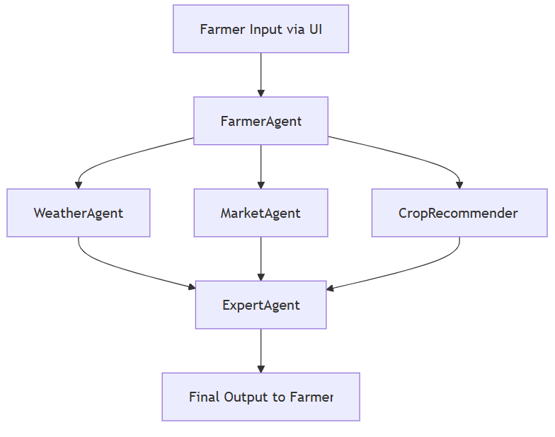
Agents' interaction design
This architecture empowers farmers with data-driven decisions.
Farmer Input via UI triggers the system.
FarmerAgent coordinates with:
WeatherAgent for climate insights
MarketAgent for price trends
CropRecommender for optimal crop choices
All insights are consolidated by ExpertAgent
Final, tailored advice is delivered to the Farmer

Slide 7
Code structure
sustainable-farming-ai/
│
├── app.py # Streamlit interface
├── database.py # SQLite connection and setup
│
├── /agents/ # All core agents
│ ├── farmer_agent.py # Orchestrates other agents
│ ├── market_agent.py # Market analysis and profit suggestions
│ ├── weather_agent.py # Simulates or retrieves forecast
│ └── expert_agent.py # Sustainability scoring and advice
│
├── /models/ # ML models
│ ├── crop_recommender.py # Crop prediction model
│ └── sustainability_predictor.py # Rule-based or ML scoring
│
├── /data/ # Datasets
│ ├── farmer_advisor_dataset.csv
│ └── market_researcher_dataset.csv
│
└── requirements.txt # Dependencies for deployment

Slide 8
Conclusion
Our solution bridges the gap between AI and agriculture by offering a smart, personalized, and accessible decision support system for farmers. By combining machine learning, rule-based logic, and agent collaboration, we provide real-time recommendations that are sustainable, profitable, and practical.
This system directly addresses the problem statement by:
Empowering farmers with actionable insights
Reducing environmental impact through data-driven practices
Improving profitability using market-aware crop selection
It’s simple to use, scalable, and ready to create real-world impact.

Slide 9
References/Other details
Project Repository: https://github.com/Saiprasad09/sustainable-farming-ai
Live Demo: https://sustainable-farming-ai.streamlit.app
Datasets Used:
Farmer Advisor Dataset
Market Researcher Dataset (Provided by the hackathon organizers)
Tools & Libraries:
Python, Streamlit, SQLite
scikit-learn, Pandas, NumPy

Slide 10

Thank You

